Slide 1
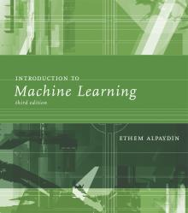
INTRODUCTION TO Machine Learning 3rd Edition
Lecture Slides for
ETHEM ALPAYDIN
© The MIT Press, 2014
alpaydin@boun.edu.tr
http://www.cmpe.boun.edu.tr/~ethem/i2ml3e

Slide 2
CHAPTER 4-5: UnIvarIate & MultIvarIate AnalysIs

Slide 3
Parametric Estimation
Now that we have studied one probabilistic approach for classification i.e., Bayes’ Rule. It is time to estimate it unknowns from the training data.
prior
likelihood
posterior
evidence

Slide 4
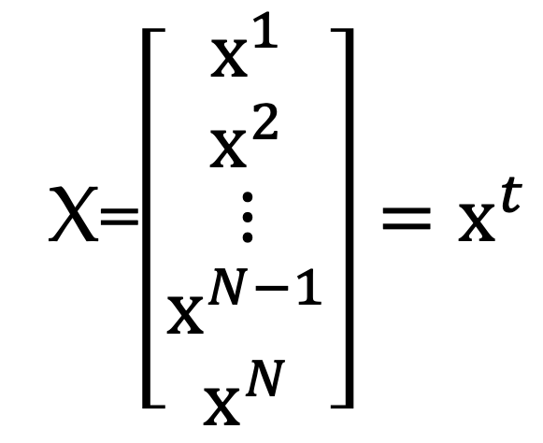
Univariate Data
X=$\left[\begin{matrix}x^{1} \\ x^{2} \\ \begin{matrix}⋮ \\ x^{N−1} \\ x^{N}\end{matrix}\end{matrix}\right]=x^{t}$

Slide 5
Parametric Estimation
X = { x^{t} } where x^{t} ~ p (x)
For example, mean and variance are enough parameters to judge an underlying distribution of the data.
Parametric estimation:
Assume a form for p (x |θ ) and estimate θ , its sufficient statistics, using X
e.g., N ( μ, σ²) where θ = { μ, σ²}

Slide 6
Maximum Likelihood Estimation
Likelihood of θ given the sample X
l (θ |X) = p (X | θ) = ∏_{t} p (x^{t}| θ)
Log likelihood
L(θ |X) = log l (θ |X) = ∑_{t} log p (x^{t}| θ)
Maximum likelihood estimator (MLE)
θ * = argmax _{θ} L(θ |X)
Why?

Slide 7
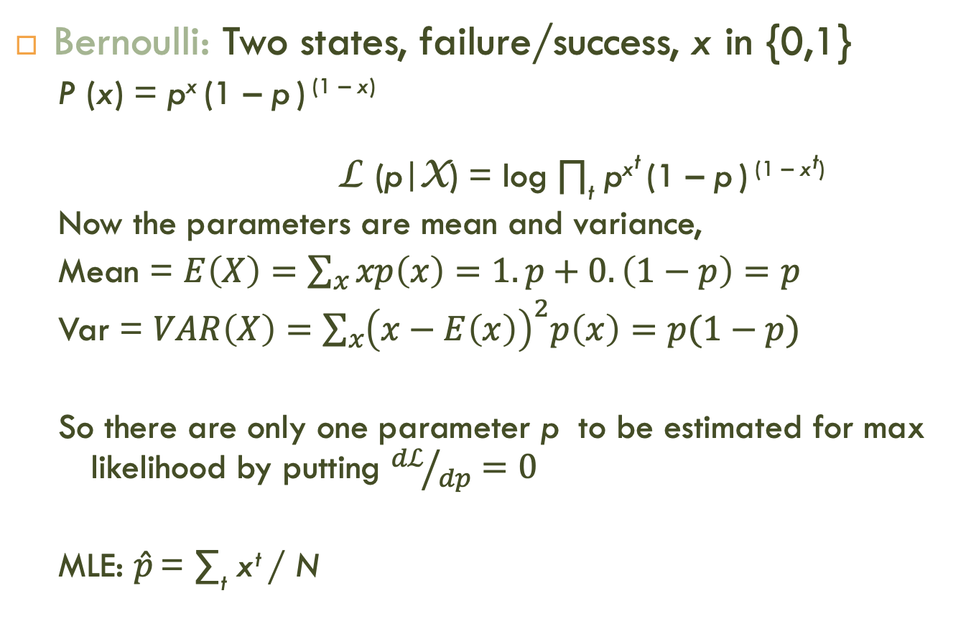
Examples: Bernoulli/Multinomial
Bernoulli: Two states, failure/success, x in {0,1}
P (x) = p^{x} (1 – p ) ^{(1 – x)}
L (p|X) = log ∏_{t} p^{xt} (1 – p ) ^{(1 – xt)}
Now the parameters are mean and variance,
Mean = $E\left(X\right)=\sum_{x}{xp\left(x\right)=1.p+0.\left(1−p\right)=p}$
Var = $VAR\left(X\right)=\sum_{x}{{\left(x−E\left(x\right)\right)}^{2}p\left(x\right)=p(1−p)}$
So there are only one parameter p to be estimated for max likelihood by putting ${dℒ}/{dp}=0$
MLE: $\hat{p}$ = ∑_{t} x^{t} / N

Slide 8

Examples: Bernoulli/Multinomial
Multinomial: K>2 states, x_{i} in {0,1}
P (x₁,x₂,...,x_{K}) = ∏_{i} p_{i}^{xi}
L(p₁,p₂,...,p_{K}|X) = log ∏_{t} ∏_{i} p_{i}^{xit}
MLE: ${\hat{p}}_{i}$= ∑_{t} x_{i}^{t} / N

Slide 9
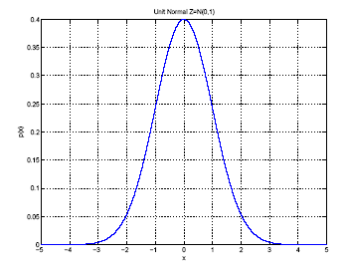
Gaussian (Normal) Distribution
p(x) = N ( μ, σ²)
MLE for μ and σ²:
μ
σ

Slide 10
Parametric Classification (Bayes’ Rule)

Slide 11
Parametric Classification (Gaussian)
Suppose the distribution is Gaussian

Slide 12
Given the sample
ML estimates are
Discriminant

Slide 13
Discriminant

Slide 14
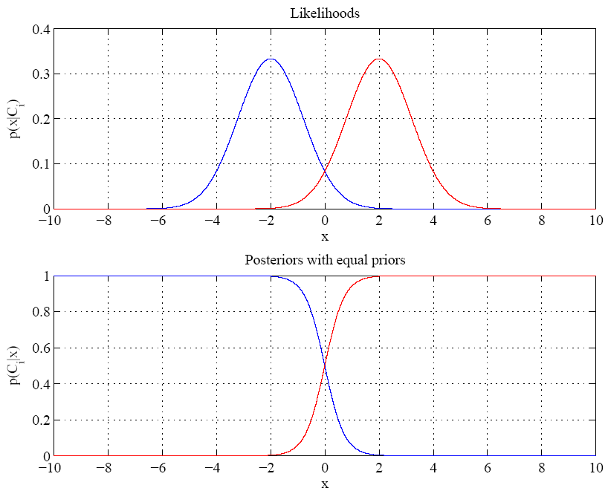
Discriminant point
Equal variances
Discriminant point
Single boundary at
halfway between means

Slide 15
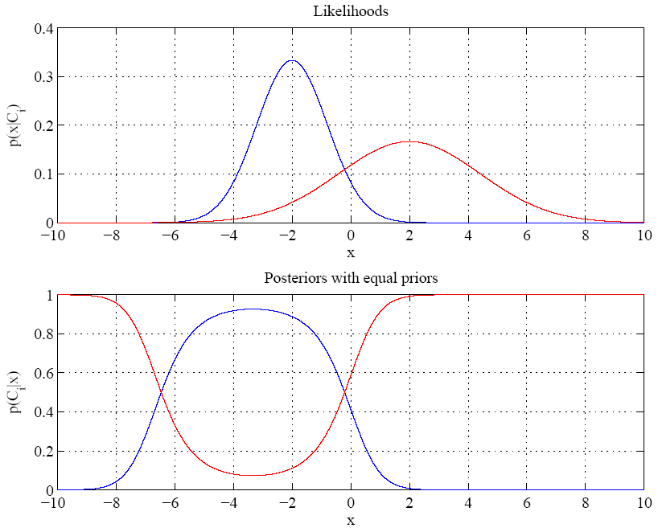
Variances are different
Discriminant points
Discriminant points
Two boundaries

Slide 16
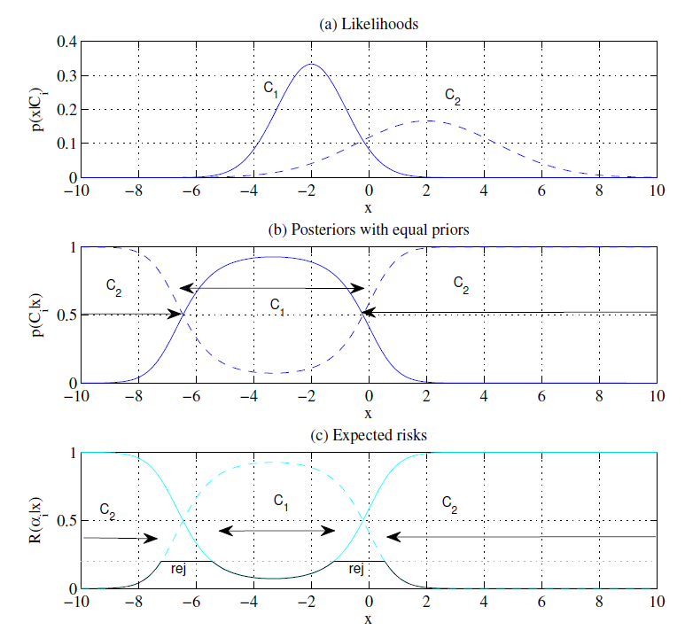

Slide 17
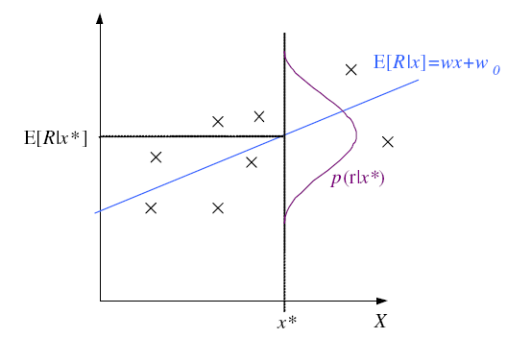
Regression

Slide 18
Regression: From LogL to Error

Slide 19
Linear Regression

Slide 20
Polynomial Regression

Slide 21
Multivariate Data
Multiple measurements (sensors)
d inputs/features/attributes: d-variate
N instances/observations/examples

Slide 22



Multivariate Data
Multiple measurements (sensors)
d inputs/features/attributes: d-variate
N instances/observations/examples
$$x^{1}$$
$$x^{2}$$
$$x^{N}$$

Slide 23
Multivariate Parameters

Slide 24
Parameter Estimation

Slide 25
Estimation of Missing Values
What to do if certain instances have missing attributes?
Ignore those instances: not a good idea if the sample is small
Use ‘missing’ as an attribute: may give information
Imputation: Fill in the missing value
Mean imputation: Use the most likely value (e.g., mean)
Imputation by regression: Predict based on other attributes

Slide 26
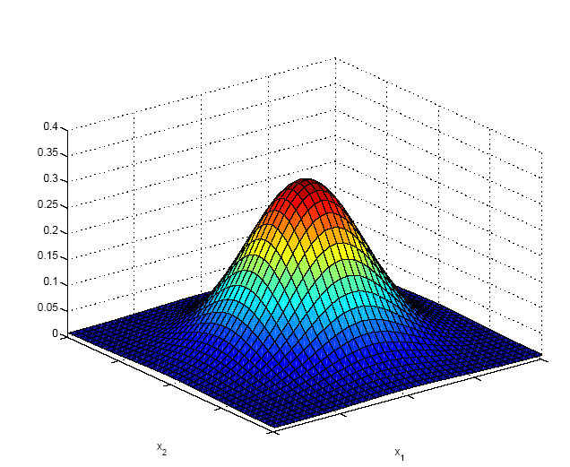
Multivariate Normal Distribution

Slide 27
Multivariate Normal Distribution
Mahalanobis distance: (x – μ)^{T} ∑^{–1} (x – μ)
measures the distance from x to μ in terms of ∑ (normalizes for difference in variances and correlations)
Bivariate: d = 2

Slide 28
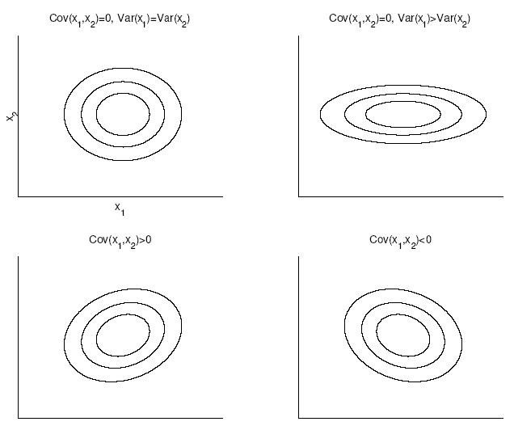
Bivariate Normal

Slide 29
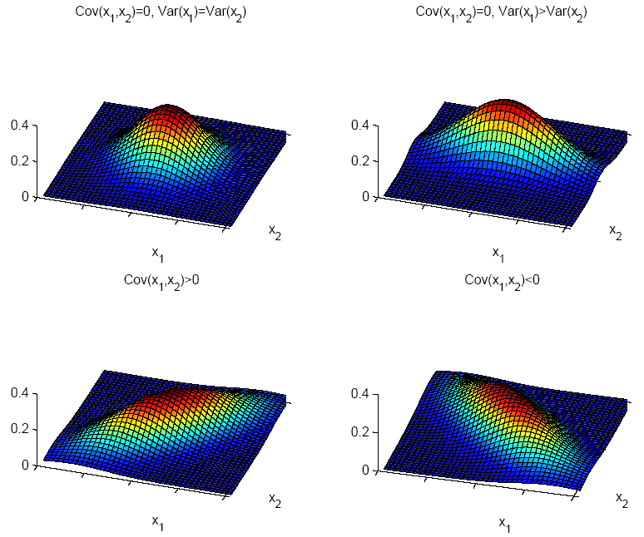

Slide 30

Independent Inputs: Naive Bayes
If x_{i} are independent, offdiagonals of ∑ are 0, Mahalanobis distance reduces to weighted (by 1/σ_{i}) Euclidean distance:
If variances are also equal, reduces to Euclidean distance

Slide 31
Parametric Classification
If p (x | C_{i} ) ~ N ( μ_{i} , ∑_{i} )
Discriminant functions

Slide 32
Estimation of Parameters

Slide 33
Multivariate Linear Regression
Multivariate linear model
Multivariate polynomial model:

Slide 34
Multivariate Linear Regression
Taking the derivative w.r.t $w_{j}, j=1,2,…d$ and equate to zero to minimise the error or maximise the likelihood

Slide 35
Multivariate Linear Regression
Lets define

